Slide 1
Web and mobile app development – csc3054/7054
2.2 Event handler

Slide 2
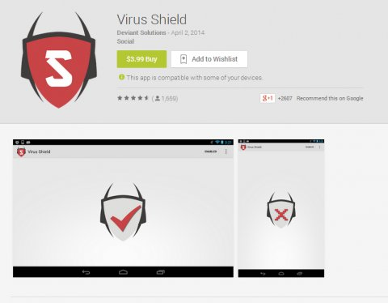
Best selling app on google play, 2014

Slide 3
What did we discuss in the last lecture?
To display a button and an image of the silent toggle mode application in a defined style.

Slide 4
Questions to be answered
What is an event in Android applications?
What components are included in Android event management? Their roles?
What is the difference between event listener and handler?
What is procedure when using buttons to change the font size of texts?
How to register a click event with a button?

Slide 5
Content outline
Event handler
Exercise
Summary
Next lecture
Further readings

Slide 6
Events
To describe state change or actions.
A way to collect data for user interface.
Examples: buttons or screen touch.

Slide 7
Android event management
Event Listeners:
This is an object that receives notification when an event happens, using the View class to build up an Android GUI.
Event Listeners Registration:
This is a process by which an Event Handler is registered with an Event Listener.
Event Handlers:
A method to handle the event.

Slide 8
Event listeners and event handlers
Event Handler | Event Listener
onClick() | OnClickListener(): This will be called when the user clicks/touches any widget (image/text/button)
onTouch() | OnTouchListener(): This is called when the user presses a key
onMenuItemClick() | OnMenuItemClickListener(): This is called when the user selects a menu item

Slide 9
Event listener registration
Deploying an inner class, onClick():
Button aButton = (Button) findViewById(R.id.MyButton); aButton.setOnClickListener(new View.OnClickListener() { public void onClick(View v) {
// User clicked my button, do something here!
}
});

Slide 10
Event listeners registration
Using an Activity class
MainActivity.java.
Revising activity_main.xml
Adding buttons to the screen.

Slide 11
Code to be built
Use IDE to create an application named “EventBuild”.
Modify MainActivity.java to put in click event listeners and handlers.
Modify activity_main.xml to include Android UI controls.
Define necessary constants in res\values\strings.xml.
Execute the application.

Slide 12
On-line demo
Please find enclosed the application named “EventBuild”.
Click on the two buttons one by one.
What changes on the “Hello World” text?

Slide 13
Mainactivity.java
//Creating button references for the buttons corresponding to their IDs through findViewById
Button sButton = (Button) findViewById(R.id.button_1);
Button lButton = (Button) findViewById(R.id.button_2);
//Register click event with first button
sButton.setOnClickListener(new View.OnClickListener() {
public void onClick(View v) {
TextView txtView = (TextView) findViewById(R.id.text_id);//Correspond the text view to its ID
txtView.setTextSize(14); //Change text size
}
});
//Register click event with second button
lButton.setOnClickListener(new View.OnClickListener() {
public void onClick(View v) {
TextView txtView = (TextView) findViewById(R.id.text_id); //Correspond the text view to its ID
txtView.setTextSize(24); //Change text size
}
});

Slide 14
Activity_main.xml
<Button
android:id="@+id/button_1"
android:layout_height="wrap_content"
android:layout_width="match_parent"
android:text="@string/button_1"/>
<Button
android:id="@+id/button_2"
android:layout_height="wrap_content"
android:layout_width="match_parent"
android:text="@string/button_2"/>
<TextView
android:id="@+id/text_id"
android:layout_width="wrap_content"
android:layout_height="wrap_content"
android:capitalize="characters"
android:text="@string/hello_world" />

Slide 15
strings.xml
<?xml version="1.0" encoding="utf-8"?>
<resources>
<string name="app_name">EventBuild</string>
<string name="action_settings">Settings</string>
<string name="hello_world">Hello world!</string>
<string name="button_1">Button 1</string>
<string name="button_2">Button 2</string>
</resources>

Slide 16
Androidmanifest.xml
<application
android:allowBackup="true"
android:icon="@drawable/ic_launcher"
android:label="@string/app_name"
android:theme="@style/AppTheme" >
<activity
android:name="com.example.eventbuild.MainActivity"
android:label="@string/app_name" >
<intent-filter>
<action android:name="android.intent.action.MAIN" />
<category android:name="android.intent.category.LAUNCHER" />
</intent-filter>
</activity>
</application>

Slide 17
Content outline
Event handler
Exercise
Summary
Next lecture
Further readings

Slide 18
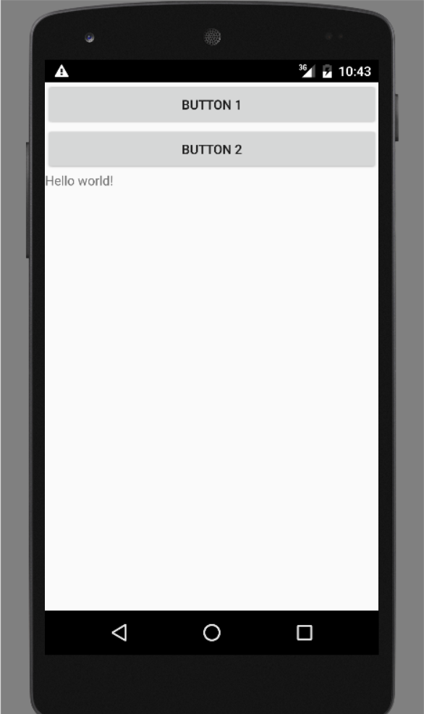
Exercise
Can you put on an extra button under “Button 2” with TextSize(34)?

Slide 19
Content outline
Event handler
Exercise
Summary
Next lecture
Further readings

Slide 20
Summary
Procedures to construct event listener and handler.
Made changes to the Java code and xml files to create required outputs.
Used buttons to change the size of the texts.

Slide 21
Content outline
Event handler
Exercise
Summary
Next lecture
Further readings

Slide 22
next lecture
To implement an event application of higher complexity.

Slide 23
Content outline
Event handler
Exercise
Summary
Next lecture
Further readings

Slide 24
Further readings
http://developer.android.com/training/index.html
Android Application Development for Dummies, Donn Felker, Wiley Publishing, Inc., NJ, 2011.

